Slide 1
Foursquare project
By: David Arbelaez

Slide 2
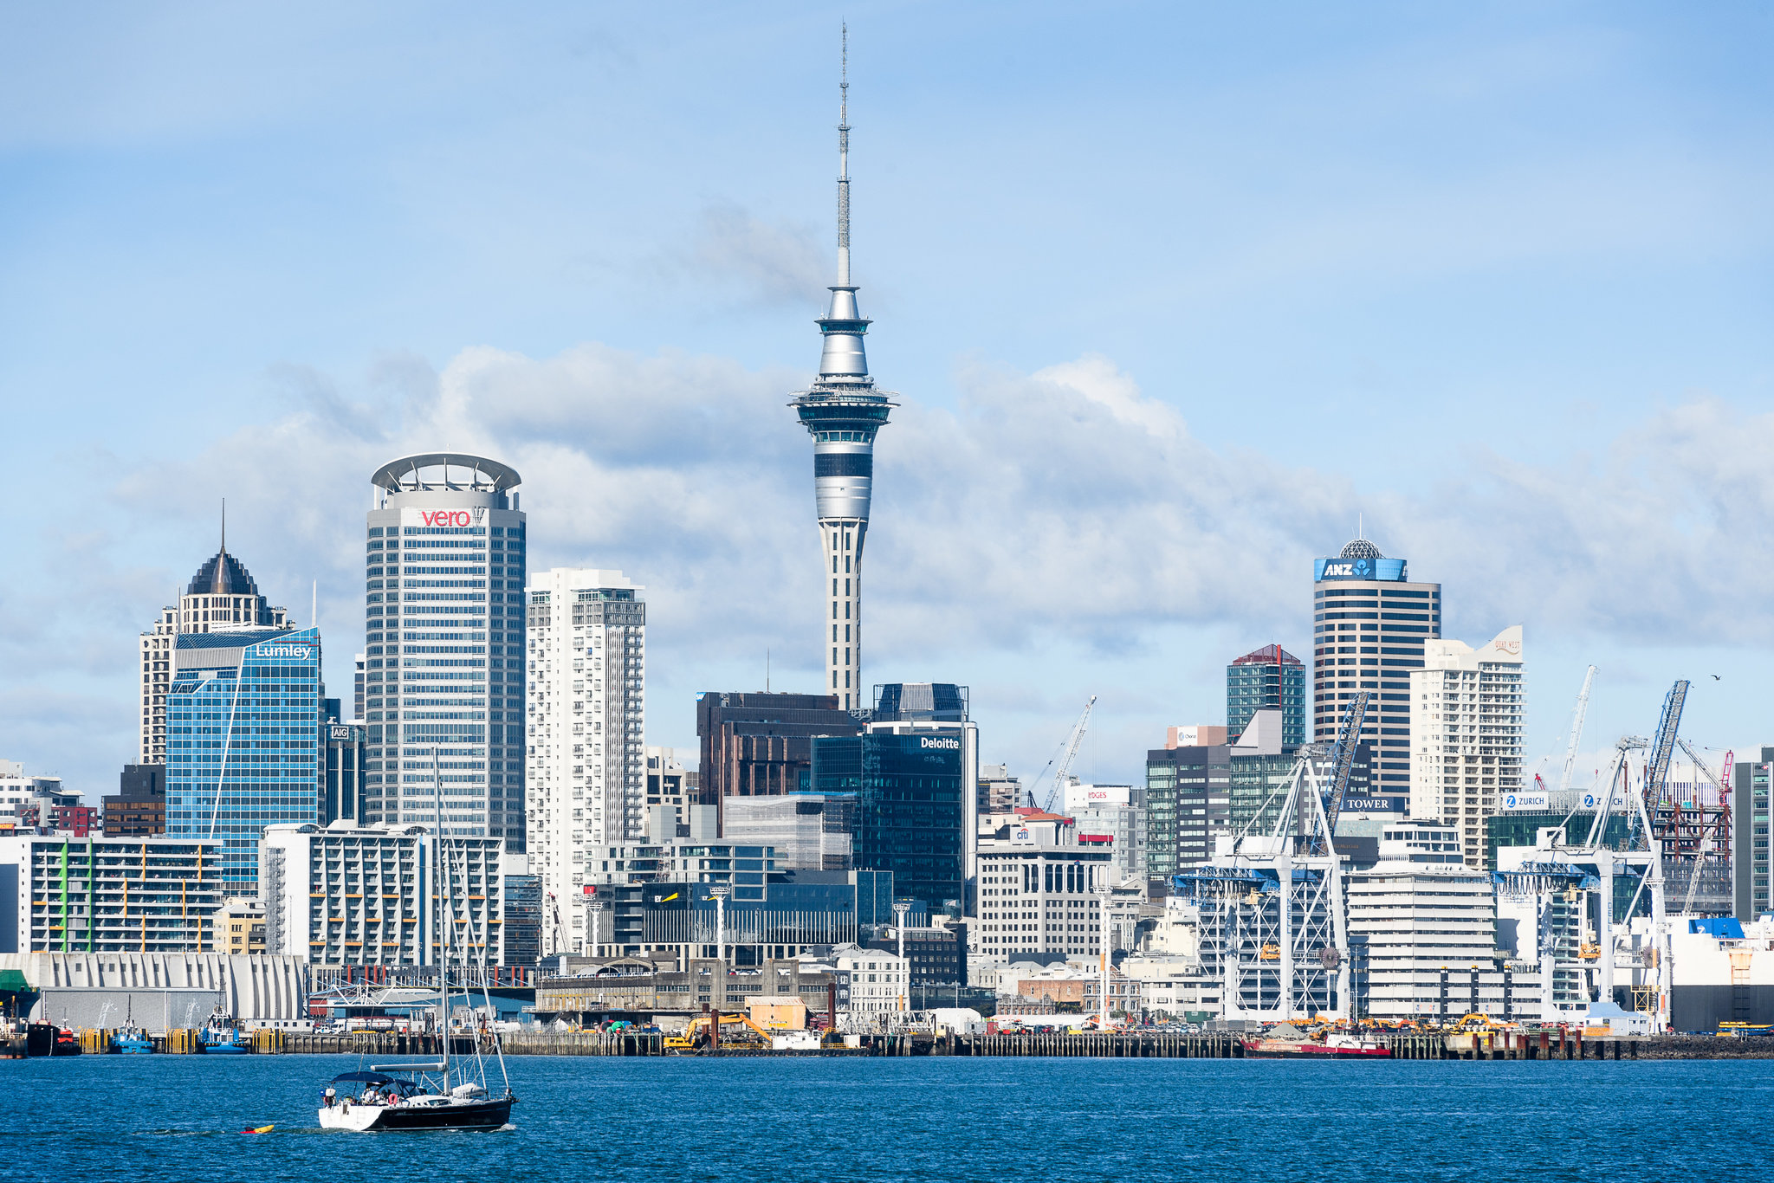
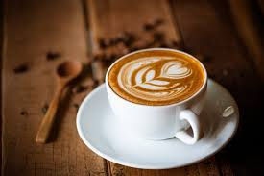
Business problem
Nowadays coffee is one of the essential drinks in a day for students, elders and people who work in a office and for this specific problem we want to start a new coffee place in the city of Auckland. So we want a the perfect zone.
The perfect zone is:
Near universities, bus stations, libraries, cinemas and theaters
Apart of the competition
People pass through

Slide 3
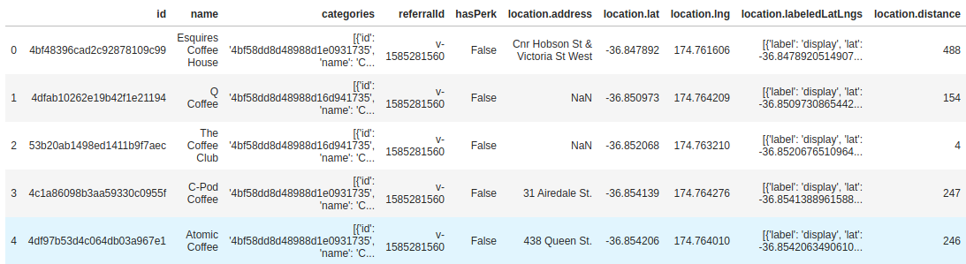
Data acquisition
All of our data came from foursquare API.

Slide 4
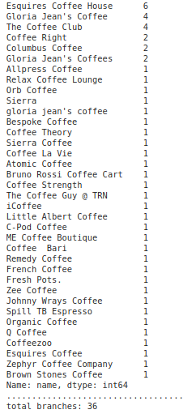
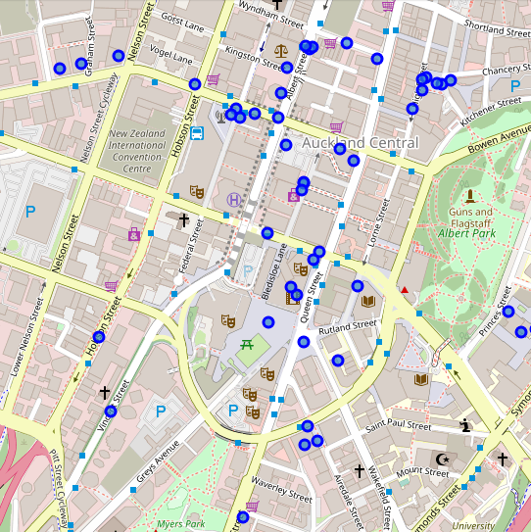
EDA
Map
Total of stores: 50
Total branches: 36

Slide 5
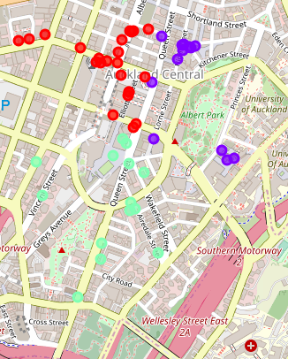
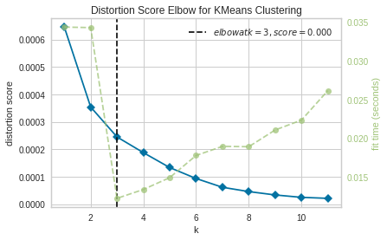
KMeans model

Slide 6
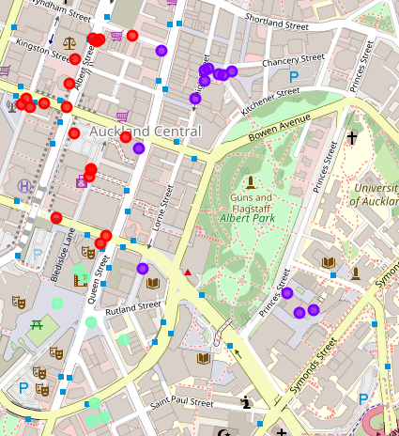
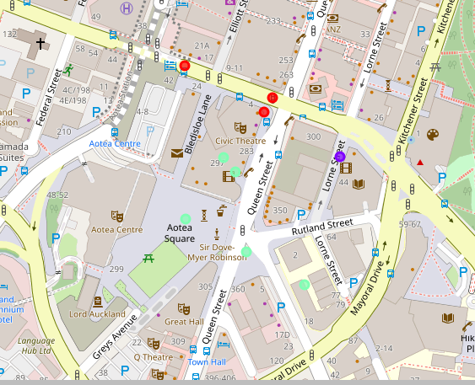
Results
There are two perfect spots to build a new coffee store

Slide 7
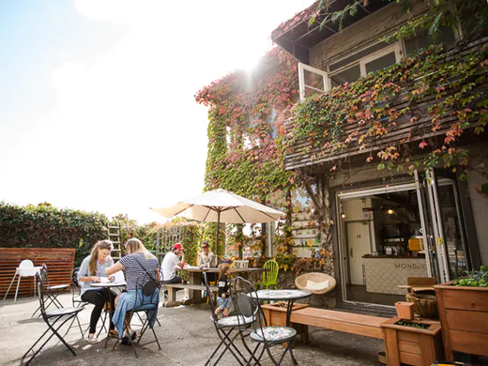
Conclusions
Finally with the result of the model and the map we can decide which zone is the best and the result shows two main zone. The best zone to choose is the one one the south west and there are two main ideas that gives us to decided that. The first one, is that the west zone shows us that is good for coffee places, for the reason they have 30 places and the second one, is the zone with more theaters and cinemas near, also there is a bus station so that shows that to many persons have to pass there.

